Slide 1


Student Academic
Performance Analysis

Slide 2







The Analytics team
Noonsavath Nithin
Project Development
Mangali Ashwini
Project development
Kyadari Bhavana
Methodology development
Papagari Manasa
Methodology development
Neerudi Baskar
Data Collection
Namilla Pundarikam
Data Collection

Slide 3

Hello everyone, today we're diving into the world of student academic performance. Our goal? To understand what makes some students succeed while others struggle in their Academics.:
Exploring student academic performance data
Analyzing data from 50 students across six semesters
Objective: Understand relationships between academic metrics and students results
Providing solutions to enhance student performance
Project Recap

Slide 4


Problem
Over 46% of students are promoted every year.
After the 1st semester, we observe a passing percentage below 60%.
Our goal is to identify the factors influencing students' promoting percentages.
We will analyze the data to uncover key factors that can enhance student performance.

Slide 5






Tools and Technology
sdfdsfs
sdfdsfs
sdfdsfs
sdfdsfs
sdfdsfs

Slide 6
Identifying Influencing Factors
Identifying Influencing Factors
Problem Identification
Process
1
Data Collection and Preparation
2
Exploratory Data Analysis (EDA)
3
4
Identifying Influencing Factors
5
Developing Solutions

Slide 7

Problem Identification
Over 46% of students are promoted every year.

Slide 8
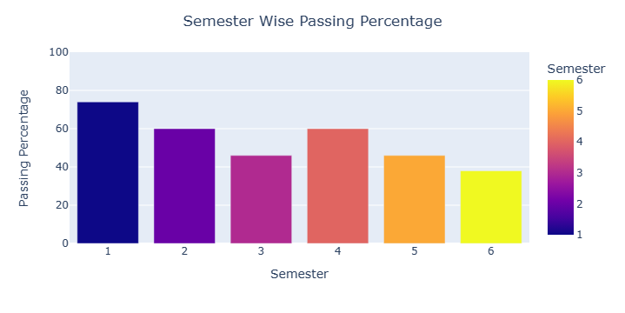
Problem Identification
After the 1st semester, we observe a passing percentage below 60%.

Slide 9
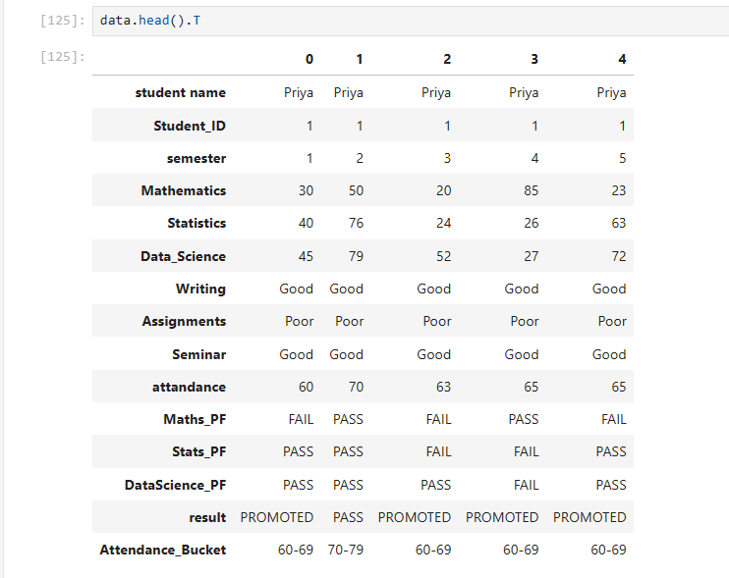
Data Collection and Preparation
We collected marks data for 50 students over six semesters.
We put together the data from student records and added some random info.
We organized the data in Excel, managing variables based on performance and other factors.

Slide 10
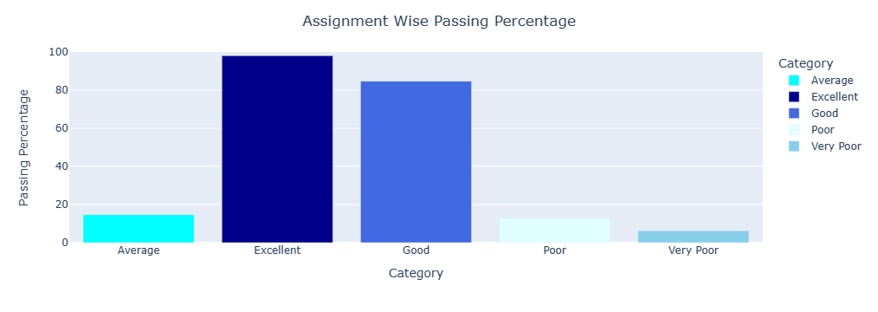
Exploratory Data Analysis (EDA)
“There is a 91% probability of passing the exam for students who perform excellently or well (good) in their assignment work.”

Slide 11
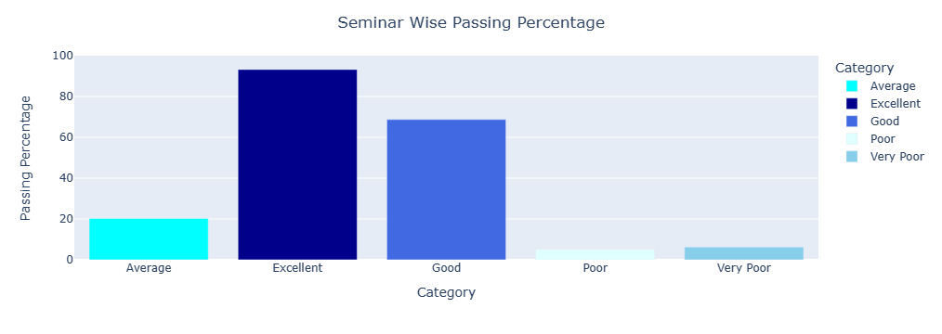
Exploratory Data Analysis (EDA)
"There is an 82% probability of passing the exam for students who demonstrate good or excellent performance in seminars."

Slide 12
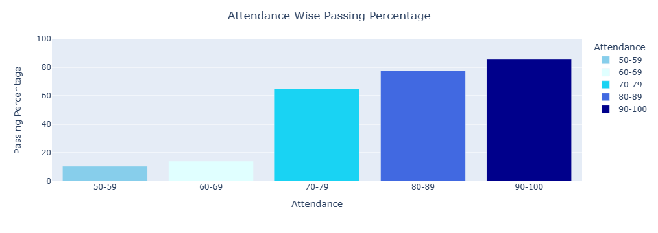
Exploratory Data Analysis (EDA)
"When students attend with attendance ranges of 70-80%, 80-89%, and 90-100%, there is an improvement in the passing percentage."

Slide 13
Factors Influencing Passing Percentage

Slide 14
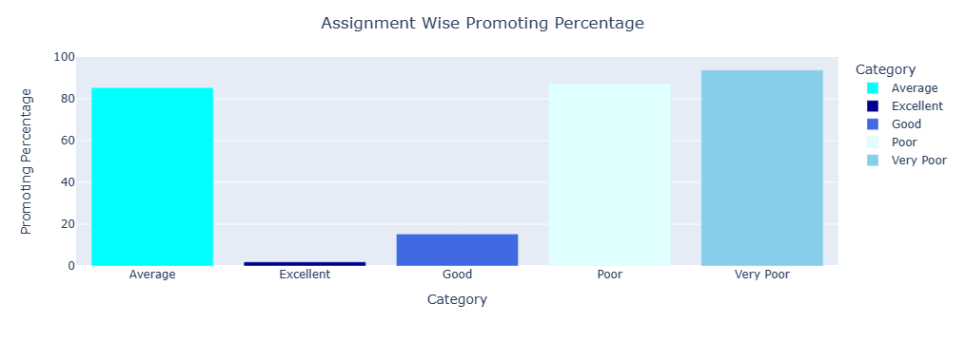
Factors Influencing Passing Percentage
"When examining the promotion percentage graph, it reveals an 89% rate of student promotion in their exams, particularly among those with poor, average, and very poor performance in their assignments."

Slide 15
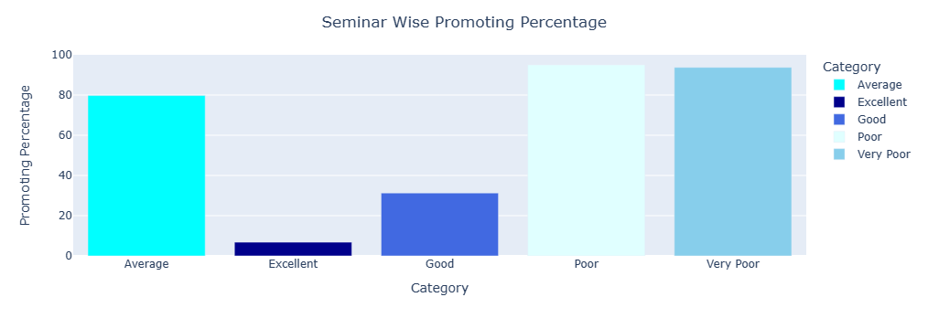
Factors Influencing Passing Percentage
"When examining the promotion percentage graph, it reveals a 90% rate of student promotion in their exams, particularly among those with poor, average, and very poor performance in their seminars."

Slide 16
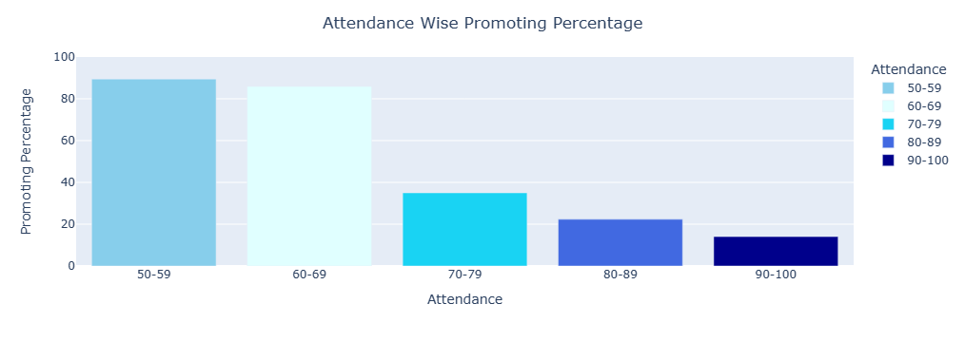
Factors Influencing Passing Percentage
"There is an 89% chance of promotion for students with attendance percentages below 70%."

Slide 17

Solutions to Improve Passing Percentage:
Improving Attendance:
Offer programs to help students with low attendance improve.
Give rewards for better attendance to motivate students.
Boosting Seminar Skills:
Create workshops to help students do better in seminars.
Provide tips on how to participate effectively.
Support for Assignments:
Give clear feedback to students who struggle with assignments.
Offer extra help like tutoring or study groups.

Slide 18
Conclusion:
Project analyzes student performance determinants.
Data from 50 students over six semesters used.
Active seminar participation and high assignment scores linked to better exam outcomes.
89% promotion rate observed for students with poor assignment performance.
Proposed solutions include attendance programs and feedback enhancements.

Slide 19
Thank you!
ANY QUESTIONS?

